Slide 2
General Project Info.
Milestone Review
Report Details.
Issues
&
Risks
Project Summary.
Project Matrics.

Slide 3
Back
General Project Information.
Project Name
Project Director
Number of Resources

Slide 4
General Project Information.
Back
Project Name
School Leadership Develop Programme.
A comprehensive project for the enhancement of leadership quality of the H. M. to promote the school activities to become a centre of excellence.

Slide 5
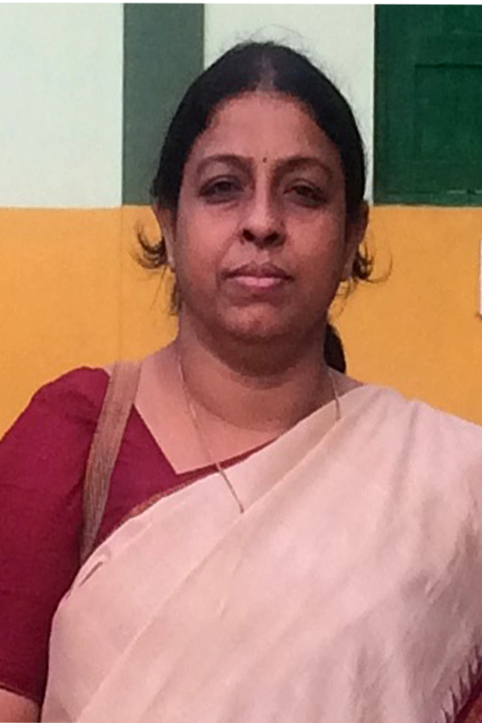
General Project Information.
Back
Project Director
PROJECT Director : DR. CHHANDA ROY.

Slide 6
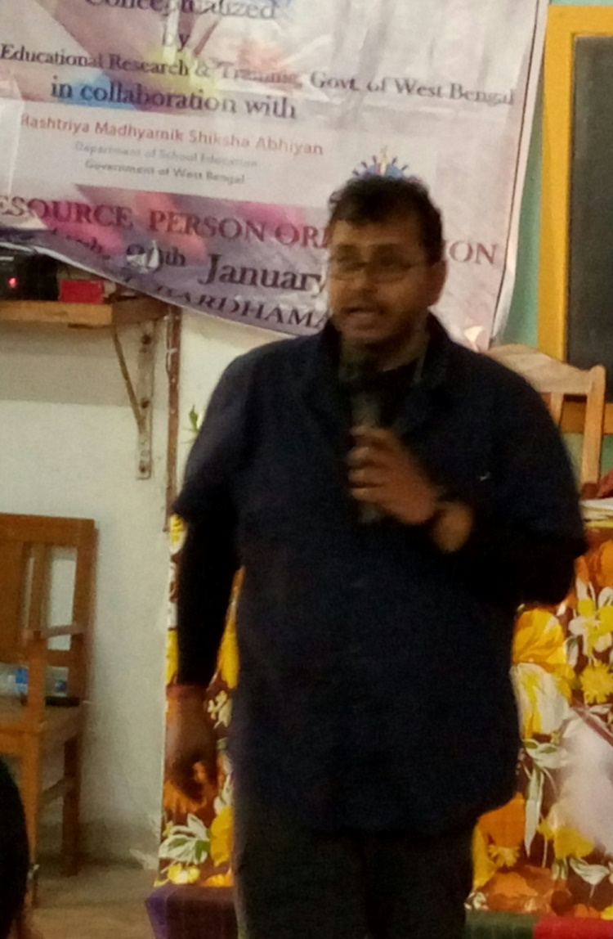
Report Details
PROJECT COORDINATOR
NEELANJAN BALA

Slide 7
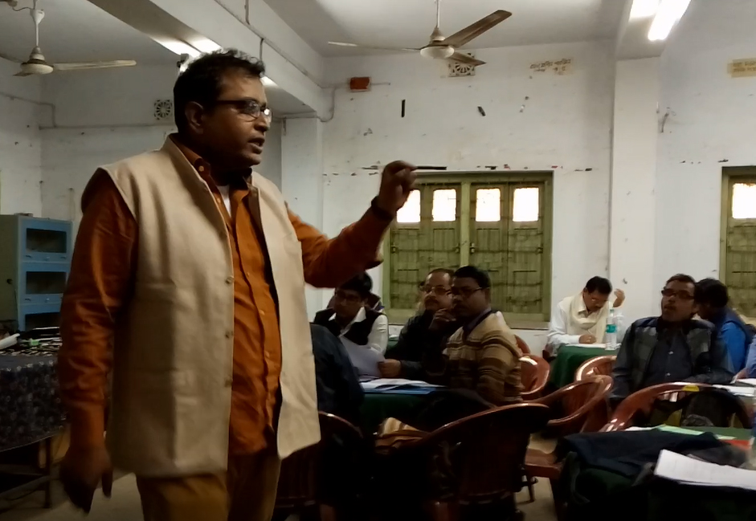
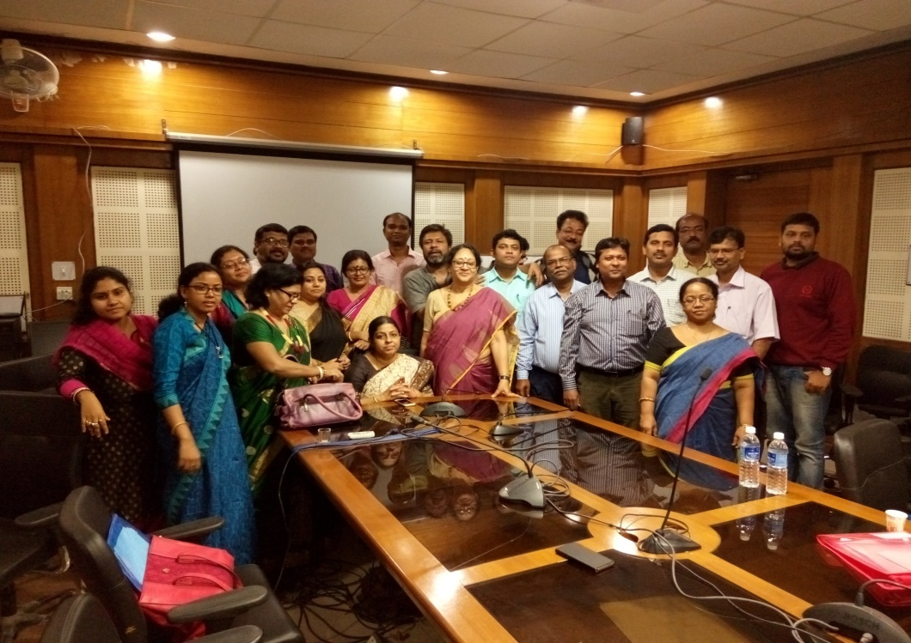
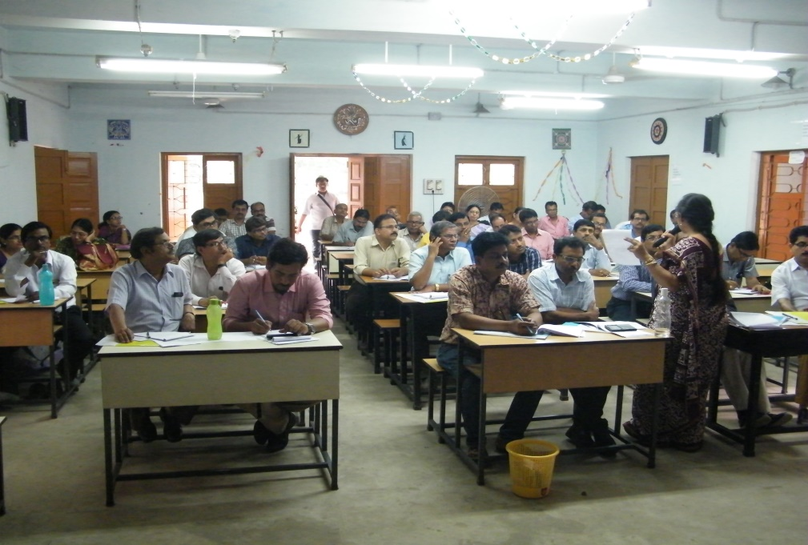
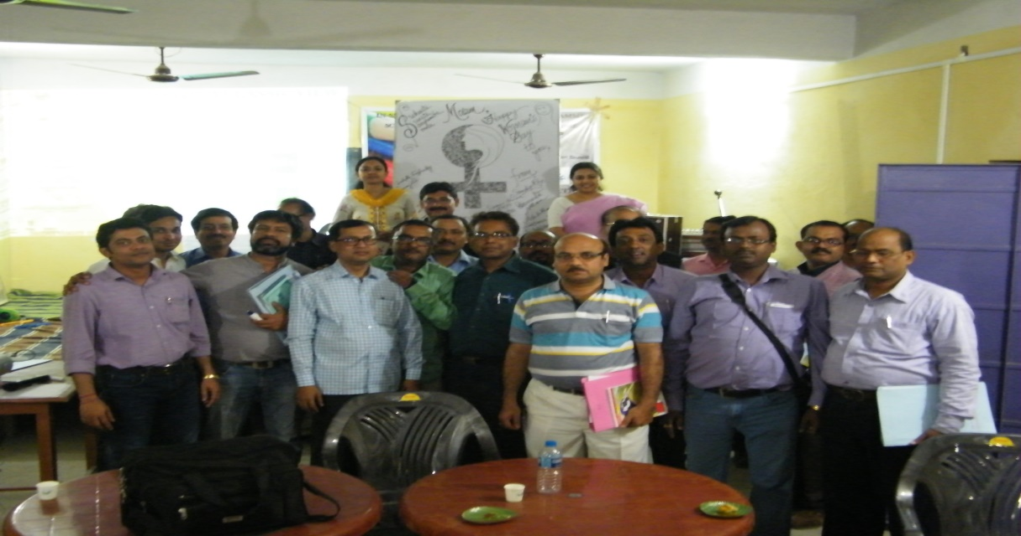
General Project Information.
Back
Number of Resources
RESOURCES
STATE COORDINATOR
STATE RESOURCE GROUP
MASTER RESOURCE PERSONS
DISTRICT RESOURCES PERSONS
H.M(S) OF SCHOOLS

Slide 8
BASIC PLAN
WHO WILL TRAIN THEM ?
PROJECT DIRECTOR AND HER TEAM
WHO WILL TRAIN THEM ?
30 S.R.G. MEMBERS
WHO WILL TRAIN THEM ?
284 M.R.P.s
WHO WILL TRAIN THEM ?
2827D.R.P.s
TARGET ADDRESSEE
All HMs OF THE H.S , SECONDARY SCHOOLS

Slide 9
S
L
D
P
FIRST PHASE TRAINING
SEVEN LEAD DISTRICTS
EVELOPMENT
ROGRAMME
EADERSHIP
HOWRAH
PURBA MEDINIPUR
CHOOL
DISTRICTS
HOWRAH
PURBA MEDINIPUR
PASCHIM MEDINIPUR

Slide 10
S
L
D
P
FIRST PHASE TRAINING
EVELOPMENT
ROGRAMME
SEVEN LEAD DISTRICTS
EADERSHIP
HOWRAH
PURBA MEDINIPUR
CHOOL
DISTRICTS
MALDA
HOWRAH
PURBA MEDINIPUR
PASCHIM MEDINIPUR
MALDA
U.DINAJPUR
D. DINAJPUR

Slide 11
S
L
D
P
FIRST PHASE TRAINING
EVELOPMENT
ROGRAMME
SEVEN LEAD DISTRICTS
EADERSHIP
HOWRAH
PURBA MEDINIPUR
CHOOL
DISTRICTS
BANKURA
HOWRAH
PURBA MEDINIPUR
PASCHIM MEDINIPUR
BANKURA
BIRBHUM
PURULIA

Slide 12
S
L
D
P
FIRST PHASE TRAINING
EVELOPMENT
ROGRAMME
SEVEN LEAD DISTRICTS
EADERSHIP
HOWRAH
PURBA MEDINIPUR
CHOOL
DISTRICTS
HOWRAH
HOWRAH
PURBA MEDINIPUR
PASCHIM MEDINIPUR
HOWRAH
PURBA MEDINIPUR
PASCHIM MEDINIPUR

Slide 13
S
L
D
P
FIRST PHASE TRAINING
EVELOPMENT
ROGRAMME
SEVEN LEAD DISTRICTS
EADERSHIP
HOWRAH
PURBA MEDINIPUR
CHOOL
DISTRICTS
NADIA
HOWRAH
PURBA MEDINIPUR
PASCHIM MEDINIPUR
NADIA
MURSIDABAD

Slide 14
S
L
D
P
FIRST PHASE TRAINING
EVELOPMENT
ROGRAMME
SEVEN LEAD DISTRICTS
EADERSHIP
HOWRAH
PURBA MEDINIPUR
CHOOL
DISTRICTS
JALPAIGURI
HOWRAH
PURBA MEDINIPUR
PASCHIM MEDINIPUR
COOCHBIHAR
ALIPURDUAR
ALIPUR DUAR
DARJEELING

Slide 15
S
L
D
P
FIRST PHASE TRAINING
EVELOPMENT
ROGRAMME
SEVEN LEAD DISTRICTS
EADERSHIP
HOWRAH
PURBA MEDINIPUR
CHOOL
DISTRICTS
BURDWAN
HOWRAH
PURBA MEDINIPUR
PASCHIM MEDINIPUR
BURDWAN
HOOGHLY

Slide 16
S
L
D
P
FIRST PHASE TRAINING
EVELOPMENT
ROGRAMME
SEVEN LEAD DISTRICTS
EADERSHIP
HOWRAH
PURBA MEDINIPUR
CHOOL
DISTRICTS
KOLKATA
HOWRAH
PURBA MEDINIPUR
PASCHIM MEDINIPUR
24 PGS NORTH
24 PGS NORTH
24 PGS SOUTH

Slide 17
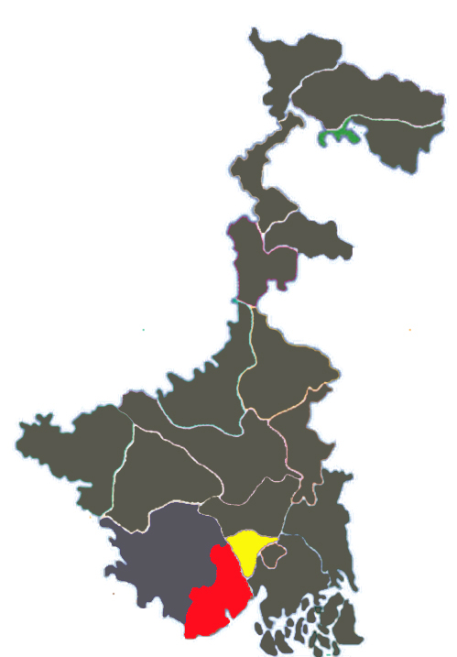
D.I.E.T. HAWRAH
S
L
D
P
VENUE
FIRST PHASE TRAINING
EVELOPMENT
ROGRAMME
EADERSHIP
HOWRAH
PURBA MEDINIPUR
CHOOL
DISTRICTS
CHURCH SCHOOL.
VENUE
11 - 14 February. 2017

Slide 18
S
L
D
P
FIRST PHASE TRAINING
DATES
EVELOPMENT
ROGRAMME
EADERSHIP
HOWRAH
PURBA MEDINIPUR
CHOOL
DISTRICTS
VENUE
D.I.E.T. HOWRAH
CHURCH SCHOOL.
DATES
11 - 14 February. 2017

Slide 19
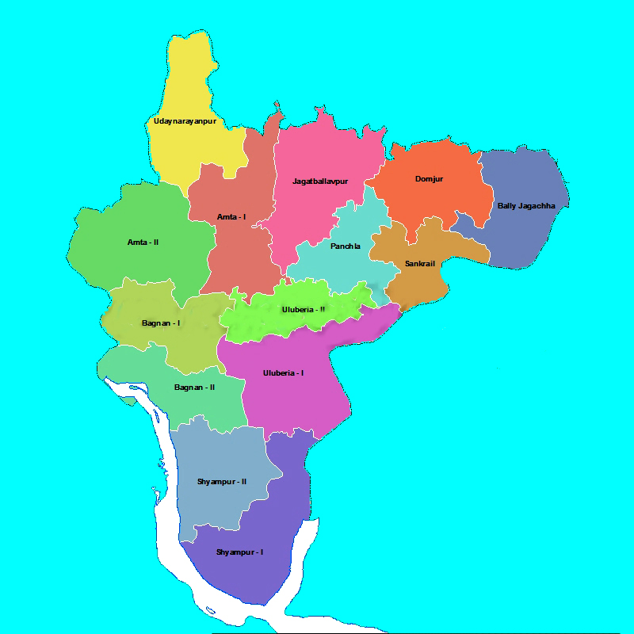
NO OF PARTICIPANTS :
HOWRAH : 9 DRPs
PURBA MIDNAPORE : 19 DRPs
NO OF PARTICIPANTS :
HOWRAH : 14 FROM EACH BLOCKS
PURBA MIDNAPORE : 21 FRPM EACH BLOCKS
FIRST PHASE TRAINING
DATES
EVELOPMENT
ROGRAMME
HOWRAH
PURBA MEDINIPUR
EADERSHIP
CHOOL
DATES
D.I.E.T. HAWRAH
S
L
D
P
DISTRICTS
VENUE
CHURCH SCHOOL.
11 TO 14 February.’17

Slide 20
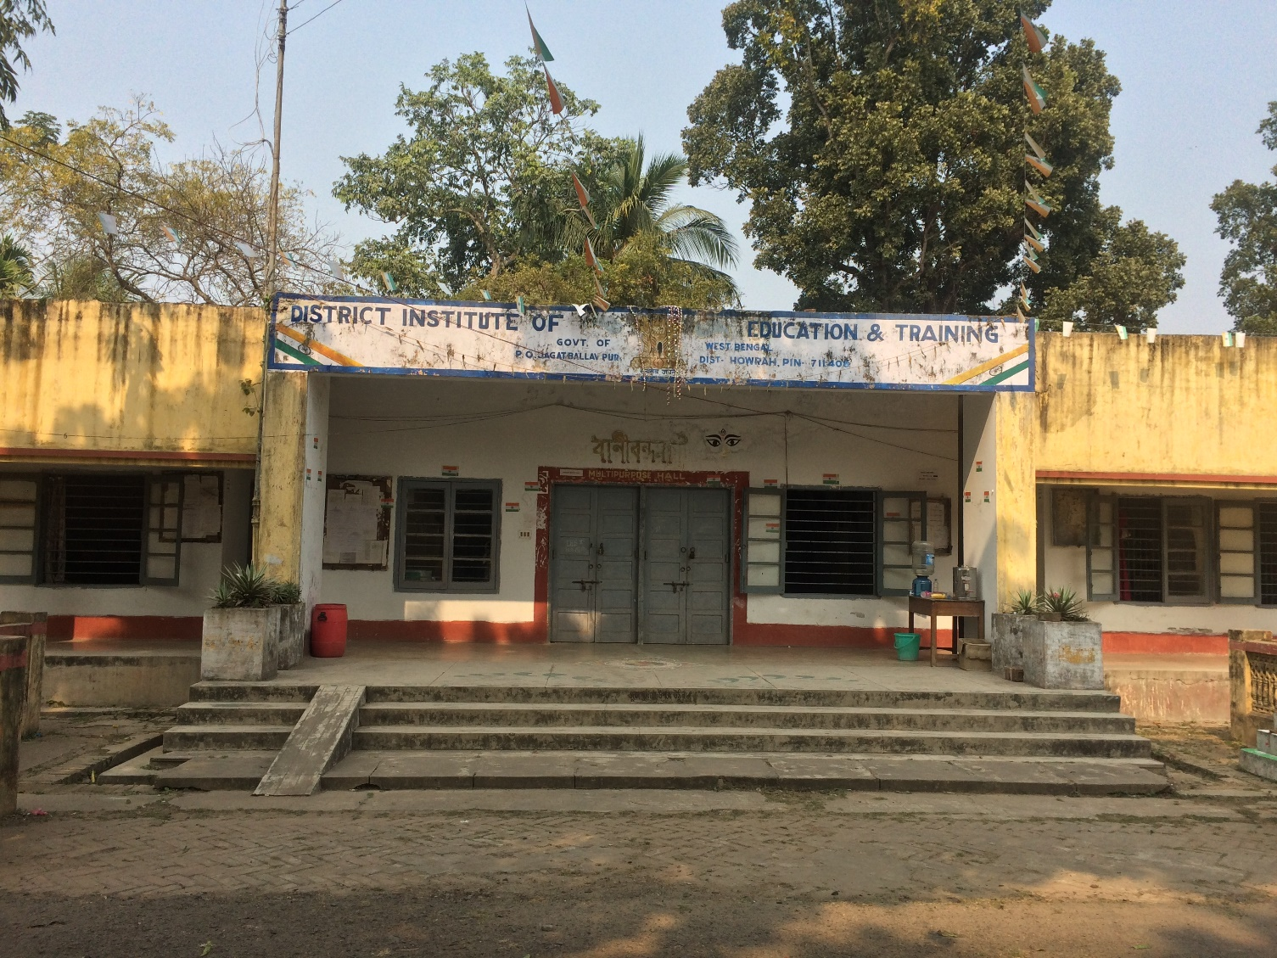
NO OF PARTICIPANTS :
HOWRAH : 9 DRPs
PURBA MIDNAPORE : 19 DRPs
FIRST PHASE TRAINING
DATES
EVELOPMENT
ROGRAMME
HOWRAH
PURBA MEDINIPUR
EADERSHIP
CHOOL
DATES
D.I.E.T. HAWRAH
S
L
D
P
DISTRICTS
VENUE
CHURCH SCHOOL.
11 TO 14 February.’17

Slide 21
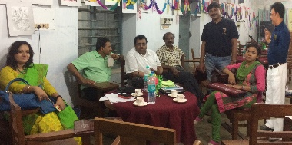
TRAINERS TEAM leaded By Dr. B.R. Manna

Slide 22
TRAINERS TEAM
Training programme for four days

Slide 23
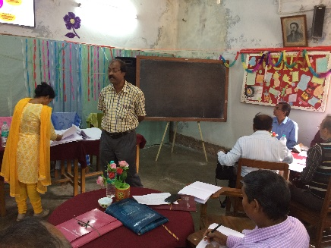
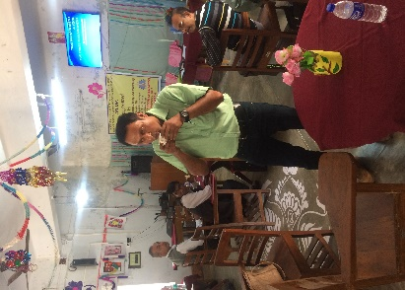
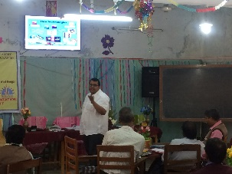
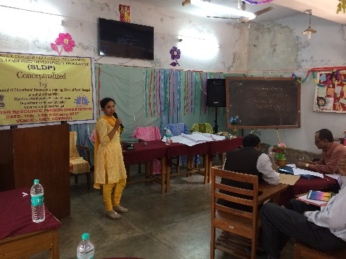
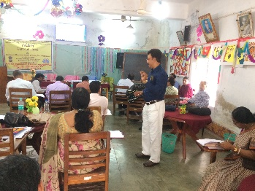
Training programme for four days

Slide 24
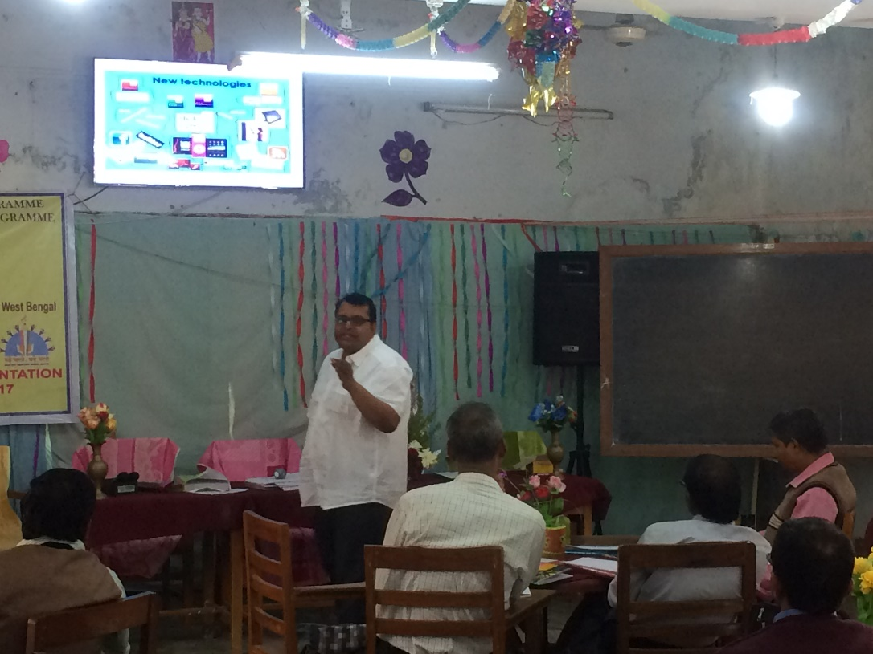
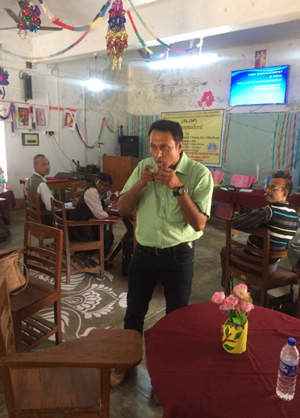
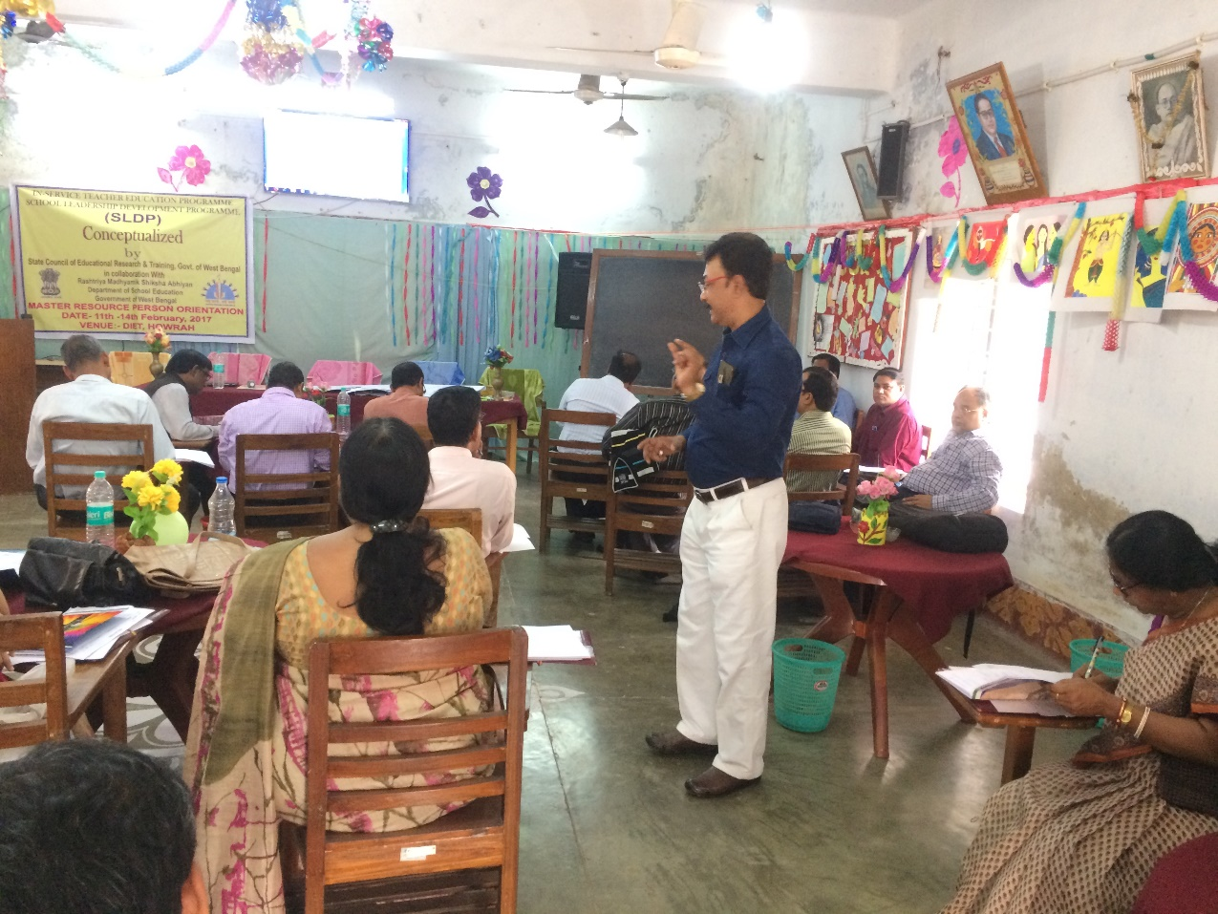
SECOND PHASE TRAINING
HOWRAH DISTRICT

Slide 25
SCHOOL VISIT BY THE SRG MEMBERS
SCHOOLS OF MRPs
SRG MEMBERS
DATE
NAME OF THE SCHOOL
Dr.K.A.SADAT
S.HANSDA
18/5/17
Jagadishpur Balika Vidyalaya
Dharsa Azad Sikshaniketan
Dr.K.A.SADAT
S.HANSDA
19/5/17
Rajapur Dakshinbari High School
Shibpur Jasodamoyee Vidyalaya
SANDIP ROY
S.HANSDA
16/5/17
B.Garden Chittaranjan Adarsha Vidyamandir
Buxarah High School
Dr.B.R.MANNA
S.HANSDA
17/5/17
Khasmorah Girls’ High School
Madhya Santoshpur High School
Dr.B.R.MANNA
S.HANSDA
19/5/17
Islampur Adarsha Madhyamik Vidyalaya

Slide 26
REPORT AT A GLANCE
BATCH : 1
19-22 JUNE
NO OF SCHOOLS
NAME OF M.R.P.
TRAINEE’S PROFILE
SCHOOL PROFILE
CASE STUDY
SHAALA SIDDHI STATUS
VENUE FOR D.R.P. TRAINING :
NEHRU BALIKA VIDYALAYA
DRP TRAINING
JAGADISHPUR GIRLS’
MAITREYI
MUKHERJEE
YES
YES
YES
REGN COMP
HOWRAH
NO OF DRPs PRESENT : 52/54
KHASMORAH GIRLS’
BINITA
SANYAL
YES
YES
YES
REGN COMP
B.GARDEN CHITTARANJAN
KHOKAN
DAS
YES
YES
YES
REGN COMP
DHARSA AZAD SIKSHANIKETAN
SUPRAKAS
KARMAKAR
YES
YES
YES
REGN COMP
RAJAPUR DAKSHINDARI
PRABHAT KR.
MONDAL
YES
YES
YES
REGN COMP
BUXARAH HIGH SCHOOL
RATIKANTA
MALAKAR
YES
YES
NO
REGN COMP
MADHYA SANTOSHPUR SCHOOL
INDRAJIT NANDI
YES
YES
YES
REGN COMP
ISLAMPUR ADARSHA M. V.
PRADIP KR.
GHOSH
YES
YES
YES
REGN COMP
SHIBPUR JASODAMOYEE
SANTANU GANGULY
YES
YES
YES
REGN COMP

Slide 27
DRP TRAINING
HOWRAH
VENUE FOR D.R.P. TRAINING :
NEHRU BALIKA VIDYALAYA
BATCH : 1
19-22 JUNE
NO OF DRPs PRESENT : 52/54
VENUE FOR D.R.P. TRAINING :
NEHRU BALIKA VIDYALAYA
BATCH : 2
27-30 JUNE
NO OF DRPs PRESENT : 51/53
PURBA MEDENIPUR
VENUE FOR D.R.P. TRAINING :
Medinipur Town School
BATCH : 1
21-24 July, 2017
NO OF DRPs PRESENT : 58/60
VENUE FOR D.R.P. TRAINING :
DIET, Jhargram
BATCH : 2
21-24 July, 2017
NO OF DRPs PRESENT : 54/55
VENUE FOR D.R.P. TRAINING :
Kharagpur Hitakarini High School
BATCH : 1
21-24 July, 2017
NO OF DRPs PRESENT : 64/68
VENUE FOR D.R.P. TRAINING :
Ghatal Vidyasagar High School
11-14 December, 2017
NO OF DRPs PRESENT : 47/50

Slide 28
AT A GLANCE
DRP TRAINING
L
PHASE
DATE
VENUE
REMARKS
Batch: | 1 | Venue: NEHRU BALIKA VIDYALAYA | Date – 19/06/17 to 22/06/17
Batch: | 2 | Venue: NEHRU BALIKA VIDYALAYA | Date – 04/07/17 to 07/07/17
P
D
1st phase
11-14 MAY ‘17
DIET
PERFORMED
S
2nd phase
16-19 MAY ‘17
SCHOOLS
PERFORMED
NO | NAME OF H.M. | NAME OF SCHOOL | DATE | MRP | SCH.PRO | PER.PRO | CASE STUDY | SH.SIDD.
87 | TAPAN KUMAR ROY | KALLYANBRATA SANGHA HIGH SCHOOL
88 | RABIN MAITY | GOBINGAPUR NETAJI VIDYANIKATAN
89 | BHIMACHARAN GHOSAL | GANESHPUR HIGH SCHOOL (H.S)
90 | PRADIP KUMAR MANNA | JOYNAGAR NASKARPUR F.C. HIGH SCHOOL
91 | TAPAS KR SIL | SIBERHANA HIGH SCHOOL
92 | ASTAPADA MOYRA | UDANG HIGH SCHOOL
93 | DIPTAIN NASKAR | BALICHAK HIGH SCHOOL
94 | GOPAL CHANDRA PARAL | PANPUR S.B HIGH SCHOOL
95 | TAPAN KUMAR DAS | AMTA PITAMABAR HIGH SCHOOL
96 | SOMA KUNDU | ANULIA MAHAMAYA VIDYAMANDIR
97 | MADHUSHREE SEN | SAMANTA NAGAR ASHAMALINA BALIKA VIDYALAYA
98 | TAPAS BISWAS | KANKRAI GANGADHAR SHIKSHAYATAN
99 | SUKUMAR ADAK | ASHANDA ADARSHA SHISHA SADAN
100 | PARTHANATH ADAK | MANSUKA HIGH SCHOOL
101 | ASIM ADHIKARY | KHILA GOPIMOHAN SIKSHA SADAN
102 | PRABHAS DAS | GARH BAWANIPUR R P INSTITUTION
3rd phase
19-22 /6/17
27-30/6/17
N.B.V.
PERFORMED
BATCH - 2

Slide 29
PASCHIM MEDINIPUR
S
L
D
P
VENUE
19/6 – 22/6
FIRST PHASE TRAINING
DISTRICT
EVELOPMENT
ROGRAMME
EADERSHIP
HOWRAH
PURBA MEDINIPUR
CHOOL
DISTRICTS
HOWRAH
PURBA MEDINIPUR
PASCHIM MEDINIPUR
CHURCH SCHOOL.
DATES

Slide 30
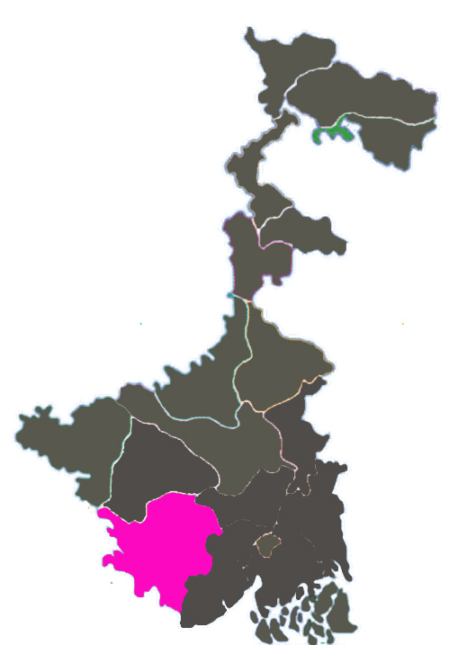
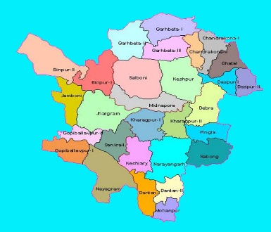
S
L
D
P
FIRST PHASE TRAINING
EVELOPMENT
ROGRAMME
EADERSHIP
CHOOL
DISTRICT
PASCHIM MEDINIPUR
VENUE
CHURCH SCHOOL.
DATES
20/6 – 23/6

Slide 31
SECOND PHASE TRAINING
PASCHIM MEDINIPUR DISTRICT

Slide 32
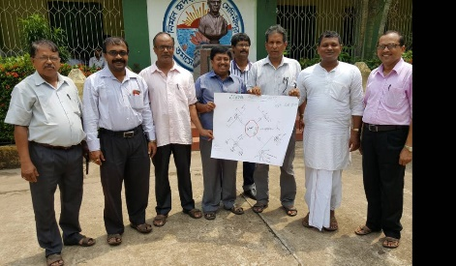
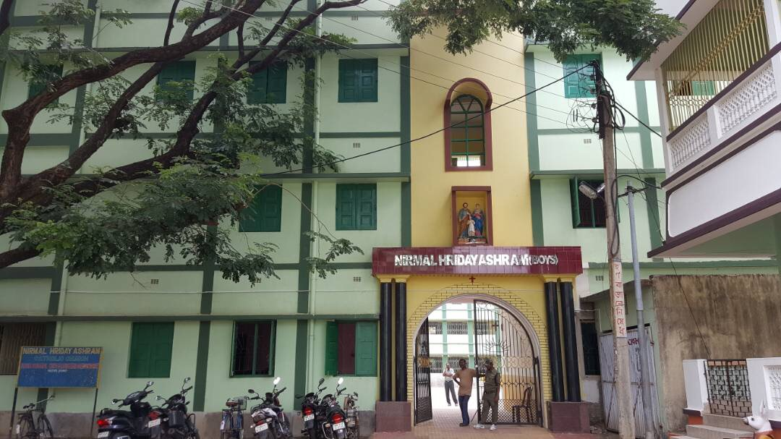
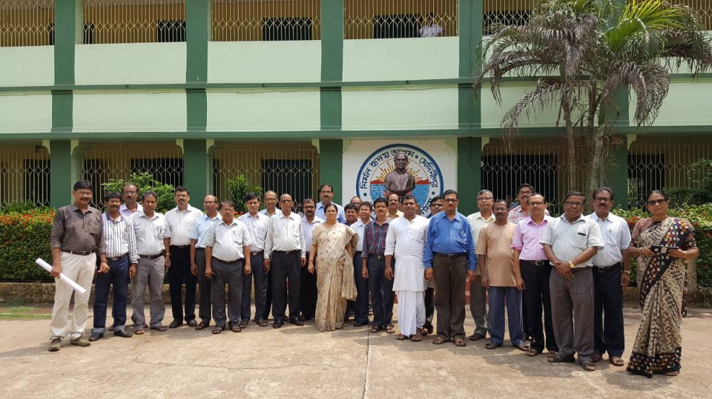
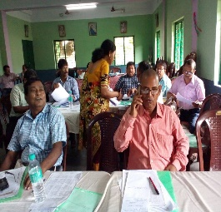
FIRST PHASE TRAINING
DISTRICT
PASCHIM MEDINIPUR.
VENUE
CHURCH SCHOOL
DATE
20 – 23 JUNE , 2017
SCHOOL VISIT BY THE SRG MEMBERS

Slide 33
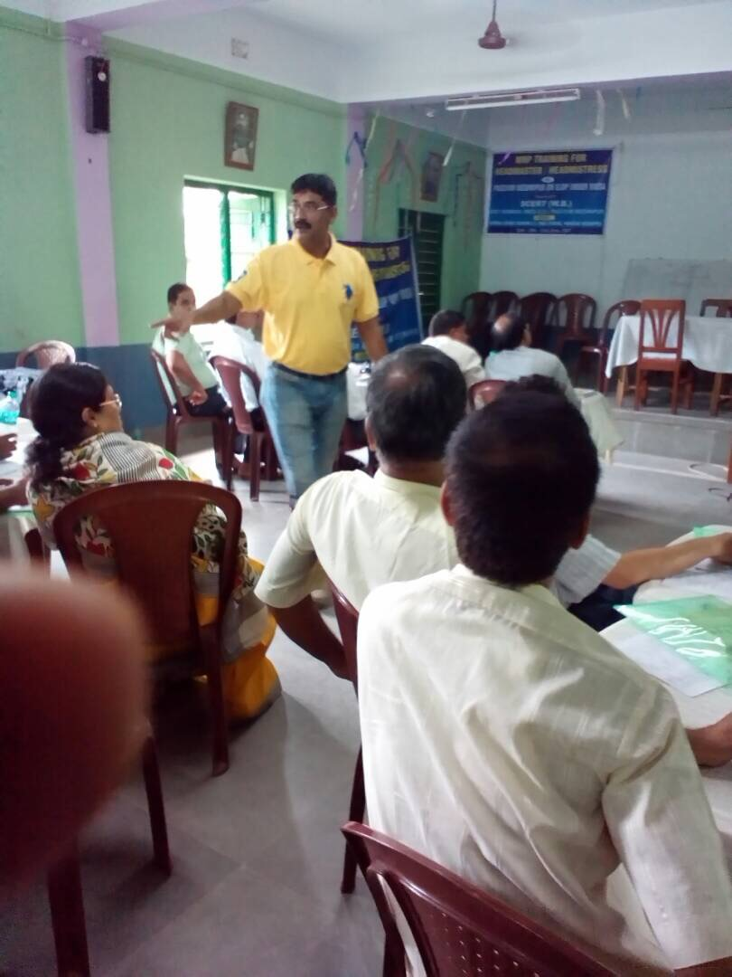
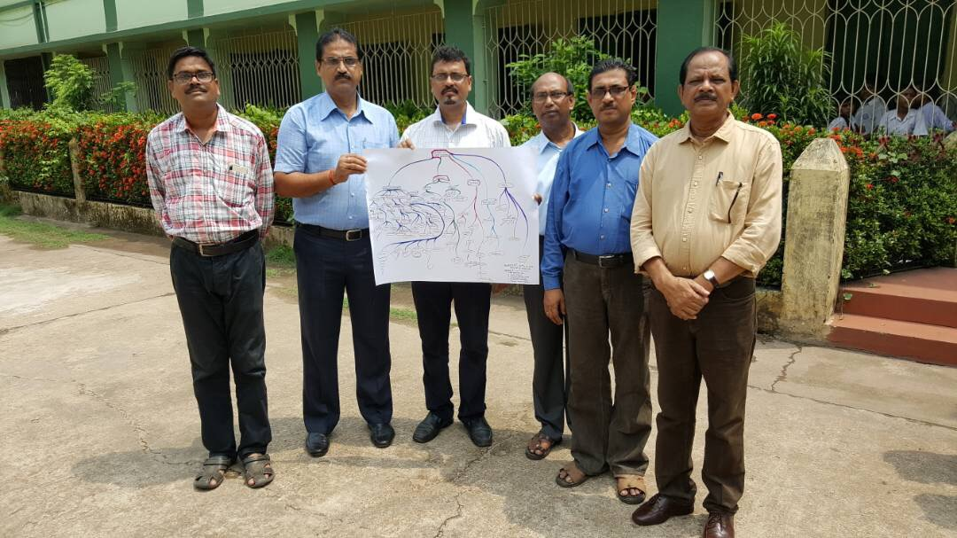
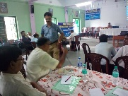
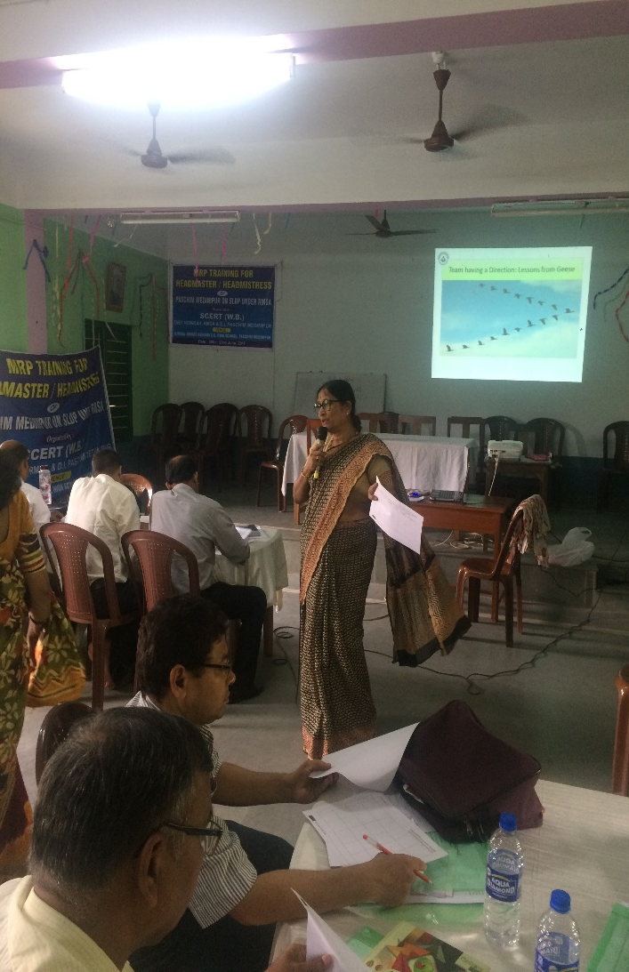
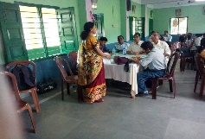
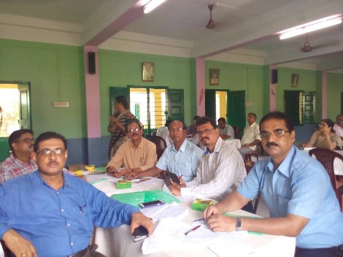
CHURCH SCHOOL
20 – 13 JUNE , 2017
VENUE
DISTRICT
FIRST PHASE TRAINING
PASCHIM MEDINIPUR.
SCHOOL VISIT BY THE SRG MEMBERS
DATE

Slide 34
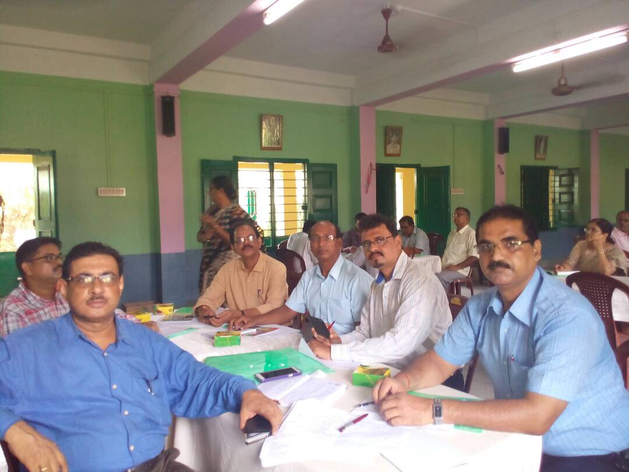
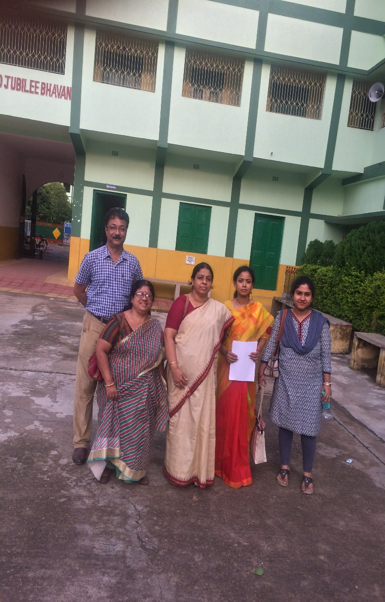
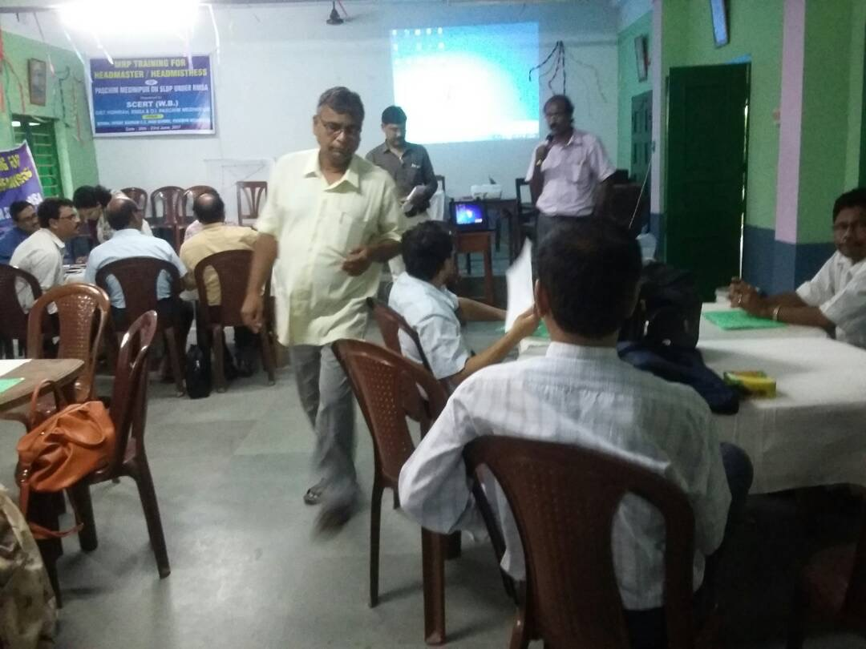
CHURCH SCHOOL
FIRST PHASE TRAINING
20 – 13 JUNE , 2017
VENUE
DISTRICT
FIRST PHASE TRAINING
PASCHIM MEDINIPUR.
SCHOOL VISIT BY THE SRG MEMBERS
DATE

Slide 35
REPORT AT A GLANCE
CHURCH SCHOOL
NO OF SCHOOLS
NAME OF M.R.P.
TRAINEE’S PROFILE
SCHOOL PROFILE
CASE STUDY
SHAALA SIDDHI STATUS
TENTULIA SARRANG
BIR KUMAR
SHEE
Y
Y
Y
REGN
KHAR HIGH SCHOOL
K.K.PANDA
Y
Y
Y
REGN
MANGLAMARO MANGALA
PRABIR KR.
MAITI
Y
Y
Y
REGN
BHERIRI BAZAR Y.S.H. SCHOOL
PRADIP KR.
MAITI
Y
Y
Y
REGN
JAHANABAD TSS H. SCHOOL
BISHNUPADA JANA
Y
Y
Y
REGN
20 – 13 JUNE , 2017
SANTARA KI HIGH SCHOOL
TAPAN KR.
MONDAL
Y
Y
Y
REGN
DISTRICT
VENUE
BICHHUNIA J. VIDYAMANDIR
RADHAMADHAB DAS
Y
Y
Y
REGN
BHAWANICHAK AC H. SCHOOL
TAPAN KR. DAS
Y
Y
Y
REGN
PASCHIM MEDINIPUR.
SCHOOL VISIT BY THE SRG MEMBERS
NAZIR BAZAR HIGH SCHOOL
DHURJATI P.
MANDAL
Y
Y
Y
REGN
DATE

Slide 36
REPORT AT A GLANCE
NO OF SCHOOLS
NAME OF M.R.P.
TRAINEE’S PROFILE
SCHOOL PROFILE
CASE STUDY
SHAALA SIDDHI STATUS
MADHABPUR HIGH SCHOOL
ASIT
BISAL
ALAI GOBORDHAN H.SCHOOL
DEBASIS
BHUNIA
BHATANBERIA SRINIBASH.SCHOOL
DEBMALYA
CHAKROBORTTY
KASARIA HIGH SCHOOL
SWAPAN DAS
SUBDI SITANATH VIDYAPITH
JANMEJOY
DINDA
MAHESHPUR HIGH SCHOOL
ASIS KR.
DAS
HALDIA PUNARBASAN VIDYANIKETAN
Dr.TAPAN KR.
JANA
BAR UTTAR HINGLI A. BALIKA V.
JAYASHRI
BERA BISWAS
DAKSHINCHAK H.S.SCHOOL
SUPRAKAS
GIRI
BYABATTAHAT ADARSA H.S.
MANAS
DHARA

Slide 37
DRP TRAINING
DHARSA AZAD SIKSHANIKETAN
SUPRAKAS
KARMAKAR
YES
YES
YES
REGN COMP
RAJAPUR DAKSHINDARI
PRABHAT KR.
MONDAL
YES
YES
YES
REGN COMP
PASCHIM MEDENIPUR
BUXARAH HIGH SCHOOL
RATIKANTA
MALAKAR
YES
YES
NO
REGN COMP
MADHYA SANTOSHPUR SCHOOL
INDRAJIT NANDI
YES
YES
YES
REGN COMP
VENUE FOR D.R.P. TRAINING :
Contai Harisabha High School,
BATCH : 1
21-24 August, 2017
NO OF DRPs PRESENT : 60/61
ISLAMPUR ADARSHA M. V.
PRADIP KR.
GHOSH
YES
YES
YES
REGN COMP
SHIBPUR JASODAMOYEE
SANTANU GANGULY
YES
YES
YES
REGN COMP
VENUE FOR D.R.P. TRAINING :
Bajkul Janakalyan Sikshaniketan
BATCH : 2
21-24 July, 2017
NO OF DRPs PRESENT : 59/60
NO OF SCHOOLS
NAME OF M.R.P.
TRAINEE’S PROFILE
SCHOOL PROFILE
CASE STUDY
SHAALA SIDDHI STATUS
VENUE FOR D.R.P. TRAINING :
Kulberia Bhimdev Adarsha Vidyapith
BATCH : 1
21-24 July, 2017
NO OF DRPs PRESENT : 65/67
JAGADISHPUR GIRLS’
MAITREYI
MUKHERJEE
YES
YES
YES
REGN COMP
KHASMORAH GIRLS’
BINITA
SANYAL
YES
YES
YES
REGN COMP
B.GARDEN CHITTARANJAN
KHOKAN
DAS
YES
YES
YES
REGN COMP

Slide 38
AT A GLANCE
DRP TRAINING
L
PHASE
DATE
VENUE
REMARKS
Batch: | 1 | Venue: NEHRU BALIKA VIDYALAYA | Date – 19/06/17 to 22/06/17
Batch: | 2 | Venue: NEHRU BALIKA VIDYALAYA | Date – 04/07/17 to 07/07/17
P
D
1st phase
20-23/6/17
CHURCH SCHOOL
DONE
S
2nd phase
1-6 /7/17
SCHOOLS
DONE
NO | NAME OF H.M. | NAME OF SCHOOL | DATE | MRP | SCH.PRO | PER.PRO | CASE STUDY | SH.SIDD.
87 | TAPAN KUMAR ROY | KALLYANBRATA SANGHA HIGH SCHOOL
88 | RABIN MAITY | GOBINGAPUR NETAJI VIDYANIKATAN
89 | BHIMACHARAN GHOSAL | GANESHPUR HIGH SCHOOL (H.S)
90 | PRADIP KUMAR MANNA | JOYNAGAR NASKARPUR F.C. HIGH SCHOOL
91 | TAPAS KR SIL | SIBERHANA HIGH SCHOOL
92 | ASTAPADA MOYRA | UDANG HIGH SCHOOL
93 | DIPTAIN NASKAR | BALICHAK HIGH SCHOOL
94 | GOPAL CHANDRA PARAL | PANPUR S.B HIGH SCHOOL
95 | TAPAN KUMAR DAS | AMTA PITAMABAR HIGH SCHOOL
96 | SOMA KUNDU | ANULIA MAHAMAYA VIDYAMANDIR
97 | MADHUSHREE SEN | SAMANTA NAGAR ASHAMALINA BALIKA VIDYALAYA
98 | TAPAS BISWAS | KANKRAI GANGADHAR SHIKSHAYATAN
99 | SUKUMAR ADAK | ASHANDA ADARSHA SHISHA SADAN
100 | PARTHANATH ADAK | MANSUKA HIGH SCHOOL
101 | ASIM ADHIKARY | KHILA GOPIMOHAN SIKSHA SADAN
102 | PRABHAS DAS | GARH BAWANIPUR R P INSTITUTION
3rd phase
21-24/7/17
THREE VENUES
DONE
BATCH - 2

Slide 39
SALIENT FEATURES OF S.L.D.P. UNDER D.I.E.T. HAWRAH
PARTICIPATION PERCENTAGE WAS REMARKABLE ( 95%)
ALL THE PARTICIPANTS GOT BOTH SOFT AND HARD COPIES OF SLDP TRAINING MATERIALS.
IN SPITE OF NATURAL CALAMITIES AND POOR COMMUNICATION , ALL TRAINING WAS COMPIITTED WITHIN THE ALLOTED TIME SCHEDULE.
ALL THE HOIs TOOK THE TRAINING PROGRAMME POSITIVELY, ENERGETICALLY AND ENTHUSIASTICALLY AS IT WAS A FIRST OF ITS KIND REGARDING SCHOOL LEADERSHIP DEVELOPMENT.
MOST OF THE HOIs, AFTER BEING TRAINED THROUGH FACE TO FACE MODE, TRIED TO IMPLIMENT THE LEARNED LESSONS IN THEIR RESPECTIVES SCHOOLS AND TRIED TO ENHANCE THEIR LEADERSHIP QUALITY.

Slide 40
PRESENTATION OF DATA OF THE REST SIX LEAD DISTRICT ARE SAME TYPE.
DETAILS ARE AVAILABLE IN WEBSITE.

